Slide 1
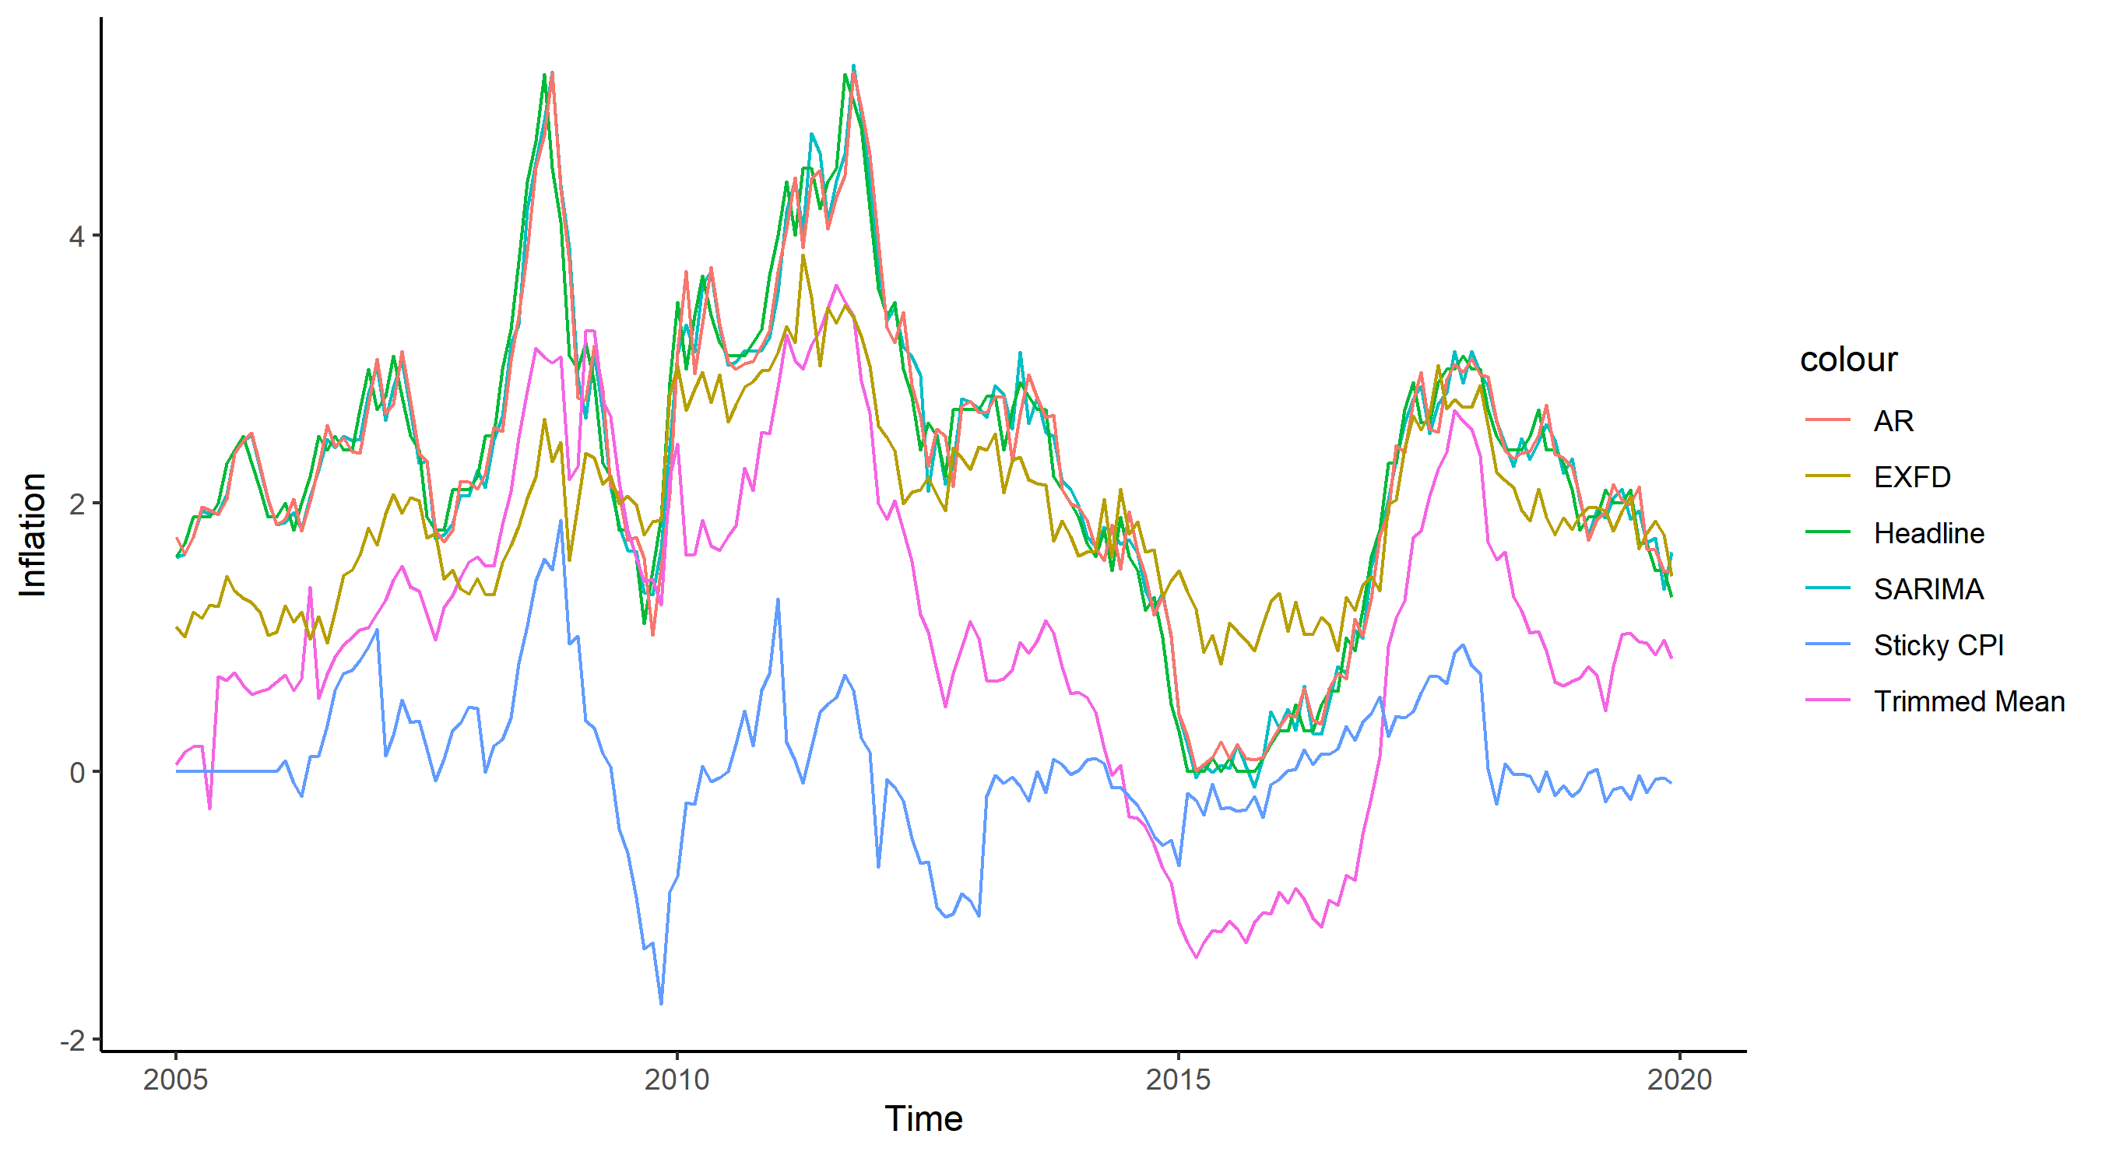

Slide 2
4
colour
AR
2
EXFD
Inflation
Headline
SARIMA
Sticky CPI
Trimmed Mean
0
-2
2005
2010
2015
2020
Time

